Slide 1

Using CloudWatch to take automated Snapshots of AWS EC2 Instance

Slide 2
Project Background
In running this project, i encountered and used various Amazon Web Services including but not limited to Elastic Compute Cloud , Instances, CloudWatch and Snapshots
i shall briefly discuss each of them in order to understand the concept and essence of the project

Slide 3
Amazon Elastic Compute Cloud, EC
Cloud computing technology is an emerging technology that is slowly taking over computing in today’s world owing to its numerous benefits
According to Amazon, Amazon Elastic Compute Cloud provides scalable computing capacity in the Cloud
Amazon EC2 enables you to scale up or down to handle changes in requirements or spikes in popularity, reducing your need to forecast traffic

Slide 4
Instances
Amazon EC2 provides a wide selection of instance types optimized to fit different use cases
Instance types comprise varying combinations of CPU, memory, storage, and networking capacity and give you the flexibility to choose the appropriate mix of resources for your applications
AWS Instances provides users with the options of running Windows, Ubuntu, Amazon Linux, Red Hat, Suse Linux, CentOS, Debian etc. operating systems on the cloud

Slide 5
CloudWatch
Information from Amazon reveals that CloudWatch provides you with data and actionable insights to monitor your applications, respond to system-wide performance changes, and optimize resource utilization
CloudWatch among other things collects monitoring and operational data in the form of logs, metrics, and events
You can use CloudWatch to detect anomalous behavior in your environments, set alarms, visualize logs and metrics side by side, take automated actions, troubleshoot issues, and discover insights to keep your applications running smoothly

Slide 6
Snapshots
Data from AWS shows that Snapshots are a sort of incremental backups, which means that only the blocks on the device that have changed after your most recent snapshot are saved
This minimizes the time required to create the snapshot and saves on storage costs by not duplicating data
Each snapshot contains all of the information that is needed to restore your data to a new EBS volume

Slide 7

Process of using CloudWatch to take automated Snapshots of AWS EC2 Instance
Select
Select a region
Navigate
Navigate to the EC2 Console
Create
Create the EC2 instance name
Choose
Choose an instance type
Configure
Configure storage
Build in
Build in security

Slide 8

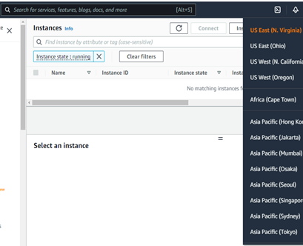



Select a region

Slide 9
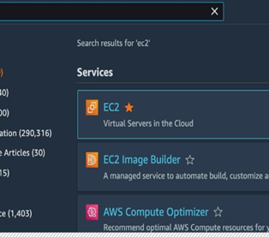
Navigate to the EC2 Console

Slide 10
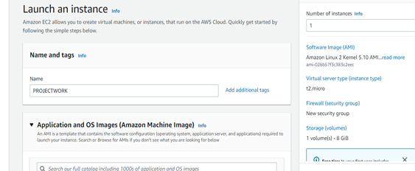
Create the EC2 instance name

Slide 11
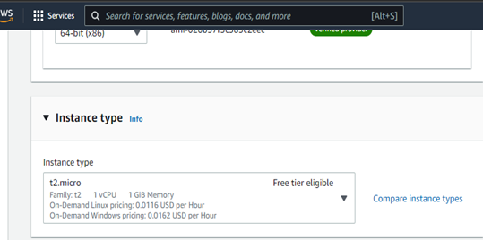
Choose an instance type

Slide 12
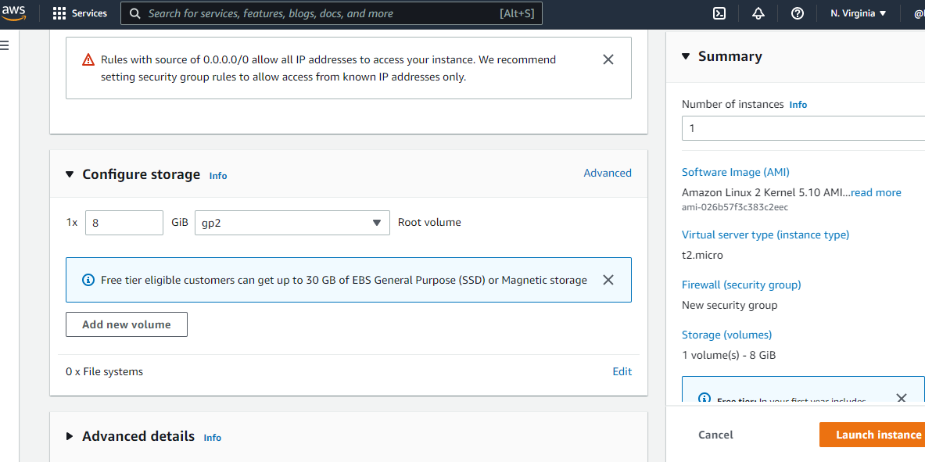
Configure storage

Slide 13
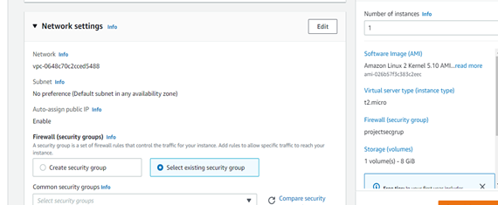
Build in security Select a subnet. Enable Auto Assign public IP. Click on advanced details and select the IAM role and allow host name to my IP. Leave every other thing at default and click on user data.

Slide 14
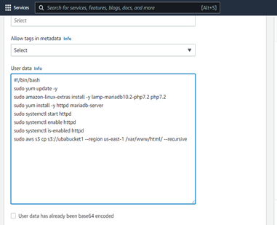
Remote into the server with SSM

Slide 15
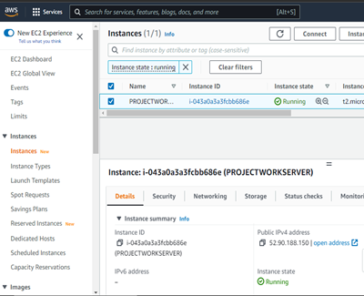
Go back to the instance you created and tick on it, then copy the DNS public address and run it in a new tab

Slide 16
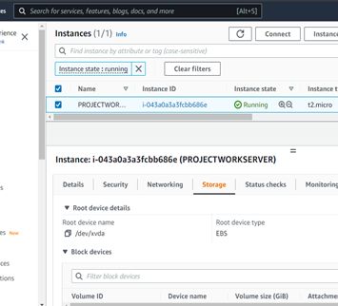
Then click on the storage and copy the instance volume ID.

Slide 17
TO ADD AUTOMATED CLOUDWATCH SNAPSHOT FOR THE EC2 INSTANCE
Open the CloudWatch console at https://console.aws.amazon.com/cloudwatch/
In the navigation pane, choose Events, Create rule
Click on create Rule
For Event Source, do the following
Choose Schedule
Choose Fixed rate of and specify the schedule interval
For Targets, choose Add target and then select EC2 CreateSnapshot API call
For ec2 id, type the instance ID of the targeted Amazon Ec2 volume and click on add target
Click on Configure details
For Rule definition, type a name and description for the rule and Choose Create rule

Slide 18
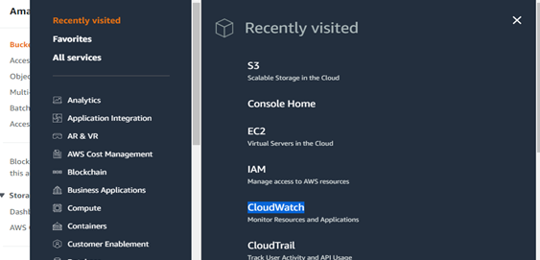
Open the CloudWatch console at https://console.aws.amazon.com/cloudwatch/.

Slide 19
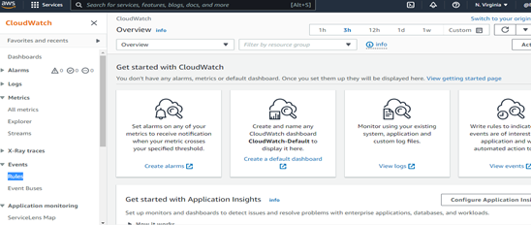
In the navigation pane, choose Events, Create rule.

Slide 20
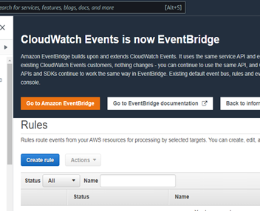
Click on create Rule.

Slide 21
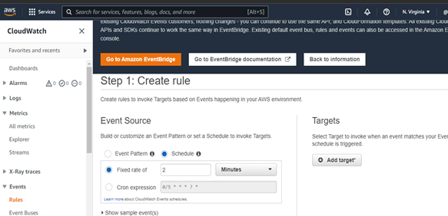
For Event Source, do the following. Choose Schedule. Choose Fixed rate of and specify the schedule interval (for example, 2 minutes).

Slide 22
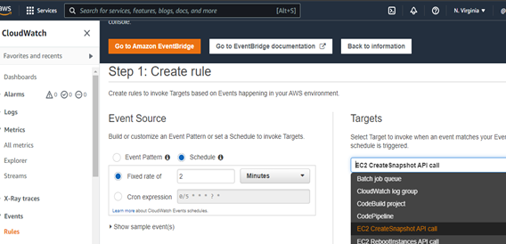
For Targets, choose Add target and then select EC2 CreateSnapshot API call. You may have to scroll up in the list of possible targets to find EC2 CreateSnapshot API call.

Slide 23
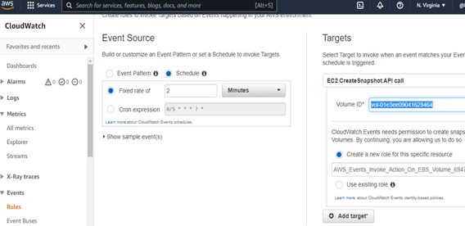
For EC2 ID, type the Instance ID of the targeted Amazon Ec2 volume and click on Add target

Slide 24
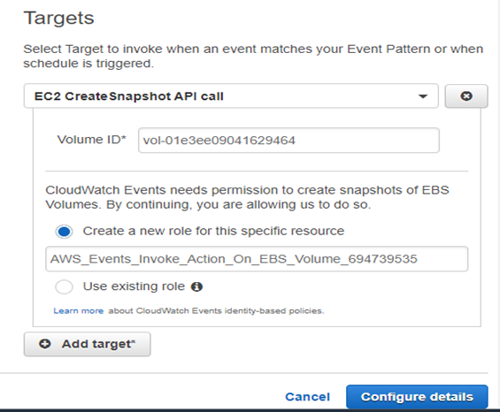
Click on Configure details

Slide 25
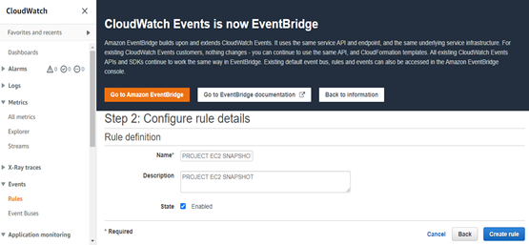
For Rule definition, type a name and description for the rule and Choose Create rule.

Slide 26
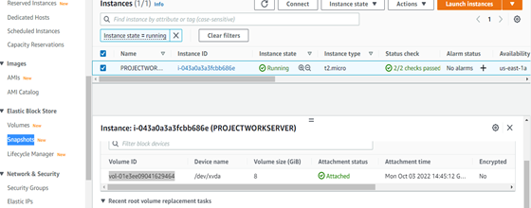
Then go back to the EC2 Instance dashboard and click on Snapshots.

Slide 27
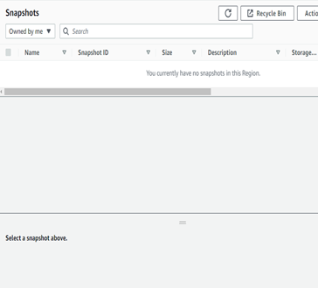
Verify that there was no snapshot

Slide 28
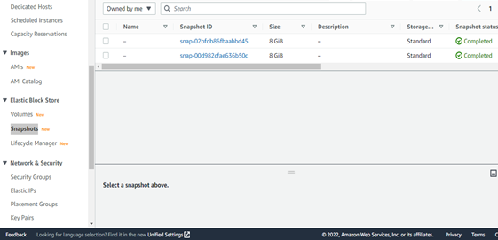
After 2 minutes, snapshot is automatically taken

Slide 29

Importance of AWS EC2 automated CloudWatch snapshoot in relation to cloud security
Snapshots are often used in storage systems to enhance data protection and efficiency and were originally created to solve several data backup problems, including recovering corrupted data, backing up large amounts of data, and increasing application performance while a backup is in process

Slide 30
Challenges i encountered
It’s an exciting learning experience, though it’s really challenging especially when we were trying to understand the EC2 snapshot and how to Automate it using CloudWatch
In this project, we learnt about AWS EC2 snapshot and automate its process using CloudWatch and the functionality of instance volume ID
my biggest challenge was to understand the whole process, the functionalities of CloudWatch, how to create the rules and how to add targets and mainly some unfamiliar terminologies
I hope to get more understanding with the process by doing more cloud project on EC2 and generally on CloudWatch so as to enable us have grounded knowledge on the processes and terminologies

